Slide 1

AFAME TECHNOLOGIES Technology Advertising Consulting
A PROJECT ON
Exploratory Data Analysis (EDA) On US Sales Data
By
Madhu Ganaveni

Slide 2
About me
Hello, I‘m Madhu Ganaveni, I have completed a Bachelor of Technology (B-Tech) degree in Civil Engineering at Jawaharlal Nehru Technological University.
I want to learn data science because it's incredibly useful. It has a big impact on different industries and can help find important information in complicated data. Learning about data science is not just interesting, but it also gives me lots of chances to work in cool areas like artificial intelligence, machine learning, and predictive analytics.
While I haven't gained any professional work experience yet, I am eager to apply my theoretical knowledge in practical settings and contribute meaningfully to projects.
Below are my GitHub and LinkedIn profiles:
GitHub: github.com/Madhu733/Data-Analysis
LinkedIn: : linkedin.com/in/madhu-ganaveni

Slide 3

Agenda:
Business Problem and Use case domain understanding:
Optimizing online sales strategy and maximizing profitability through data-driven insights. Leveraging historical sales data for analyzing product performance, customer behavior, and profitability factors.
Objective of the Project:
Analyze sales and profit trends.
Identify top-performing products and cities.
Analyze hourly sales patterns.
Evaluate city-wise performance.
Assess product-wise sales and profit.
Utilize estimated total profit for forecasting.
Create visualizations and reports for decision-making.
Dataset link: https://drive.google.com/drive/folders/1B-XPpY0vWLO66Sr8VaVFvnuQLewR6_SZ?usp=sharing

Slide 4
Summary of the Data:
The US Sales dataset contains 185686 rows × 12 columns, providing information on various aspects such as Order ID,Product, Quantity orderd, Price,Order date,Purchase Address,. Initial exploration revealed the presence of duplicate values, missing data, and outliers, which necessitated data cleaning and preparation for analysis.
Exploratory Data Analysis:
Data Cleaning: Removed duplicates, handled missing data, and filtered irrelevant entries.
Data Manipulation: Prepared data for analysis through cleaning and transformation.
Univariate and Bivariate Analysis

Slide 5
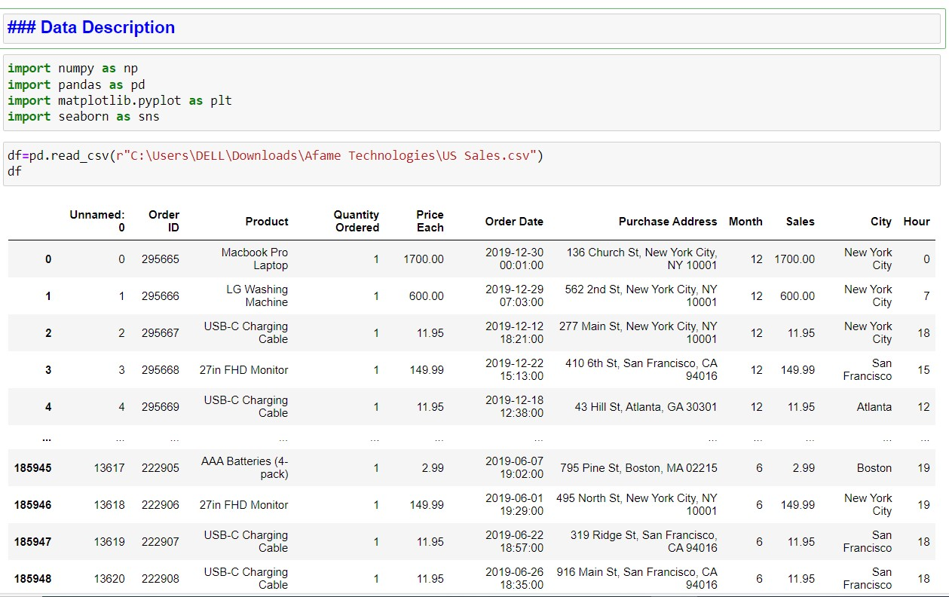

Slide 6
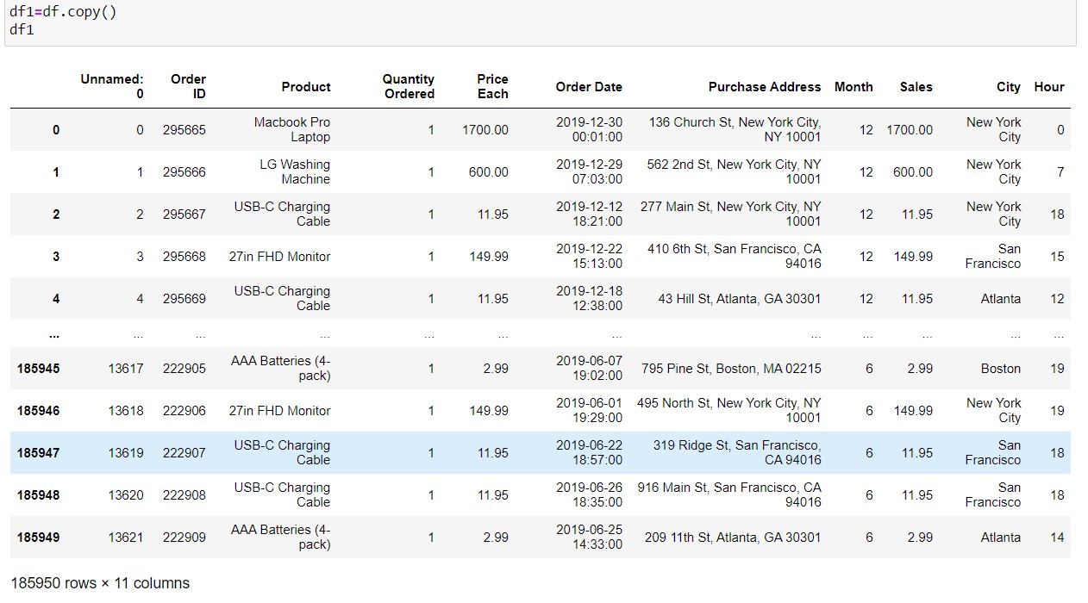

Slide 7
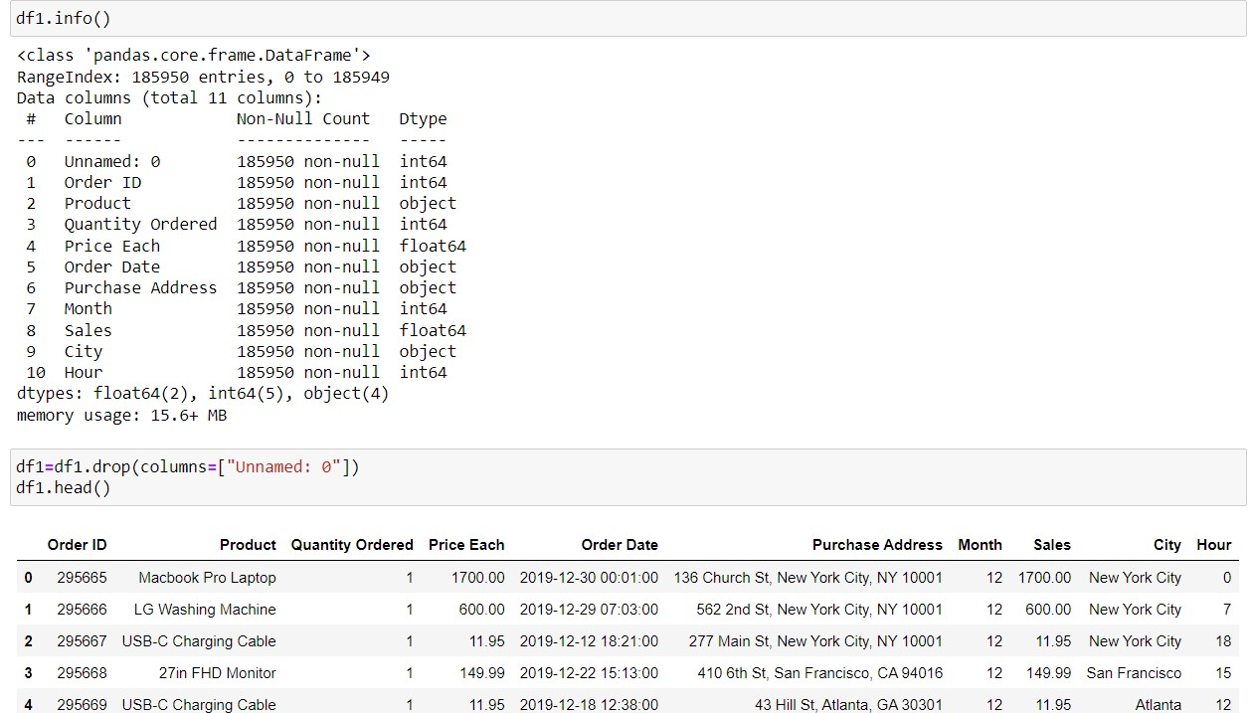


Slide 8
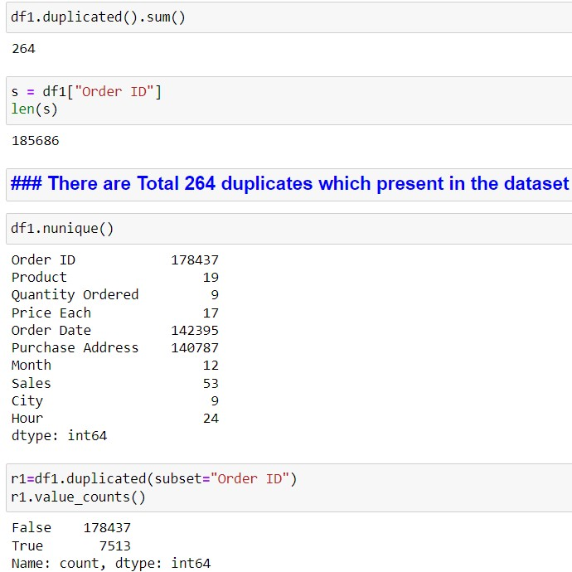
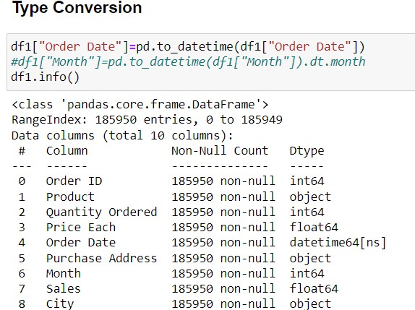


Slide 9
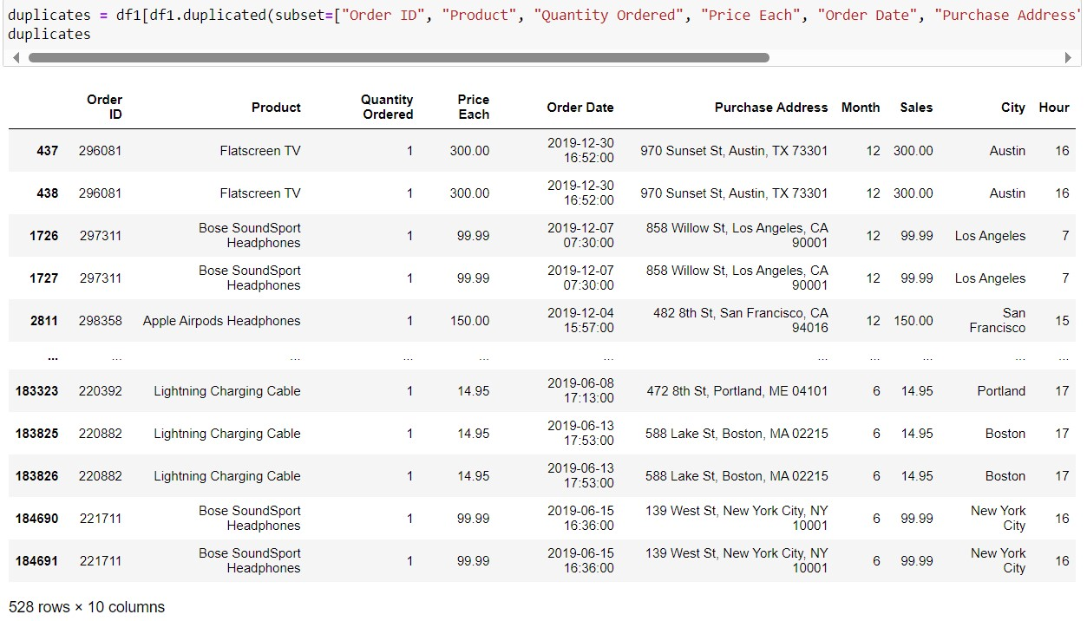

Slide 10
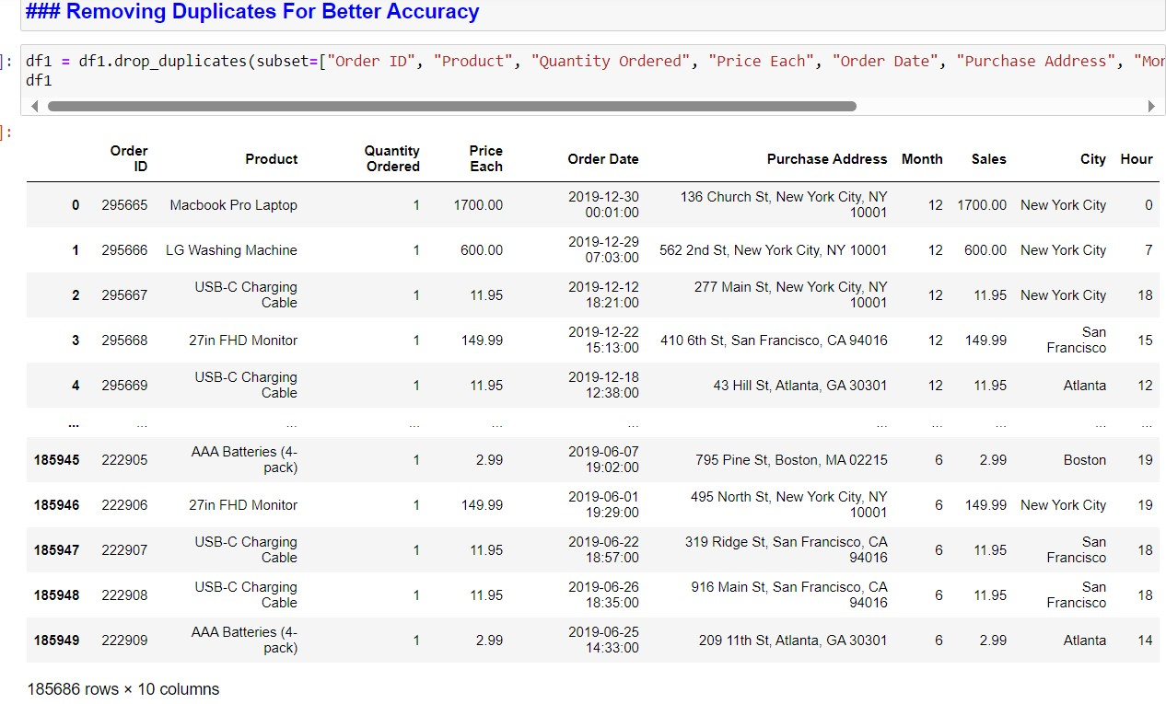

Slide 11
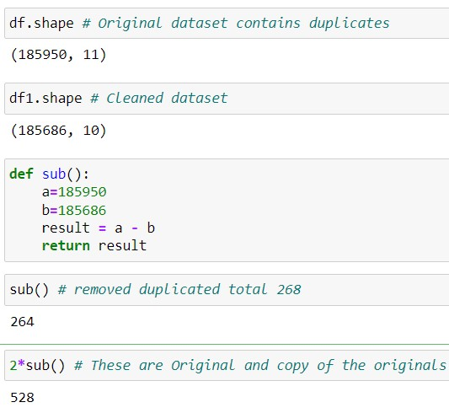

Slide 12
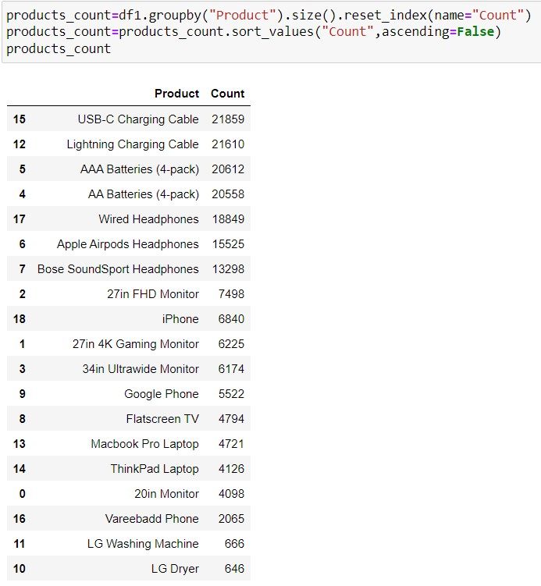

Slide 13
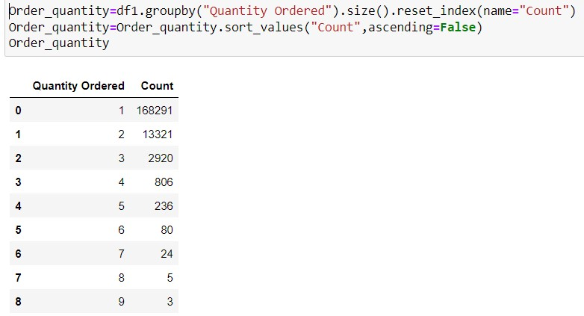
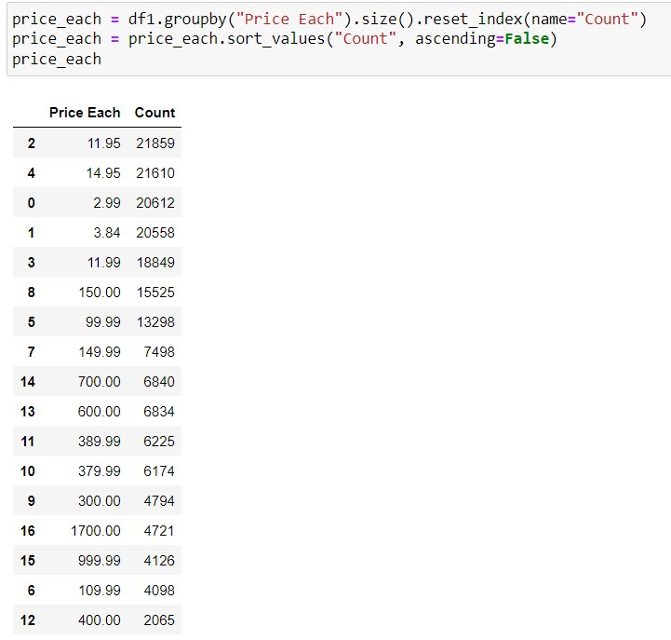

Slide 14
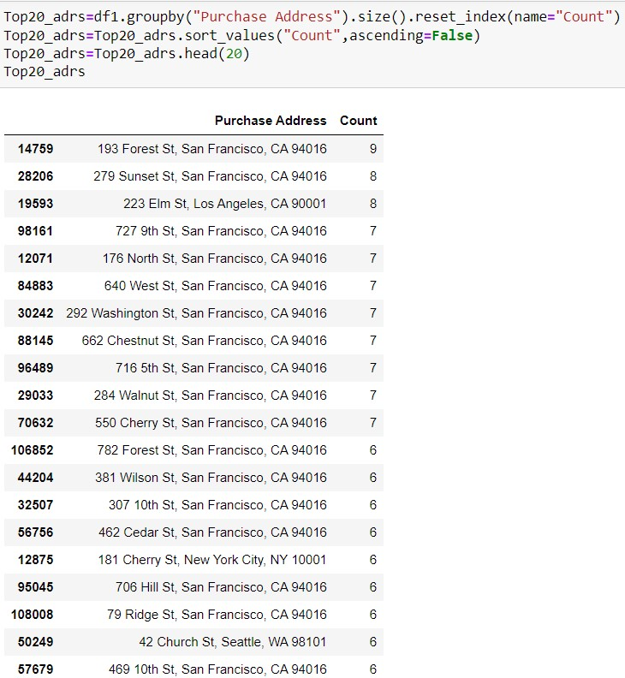

Slide 15
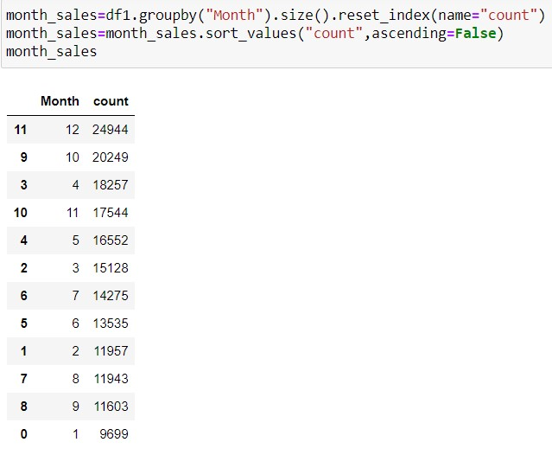

Slide 16
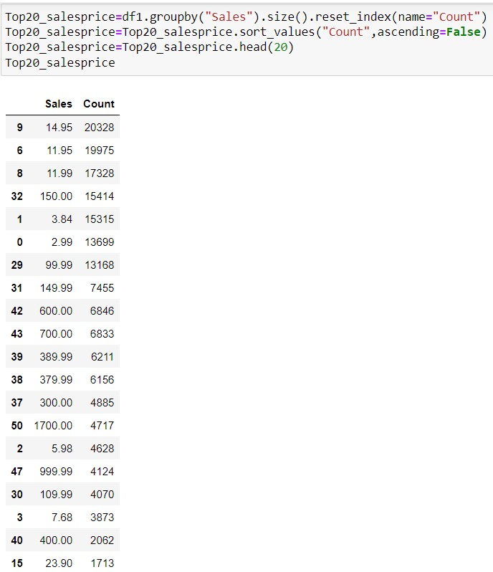
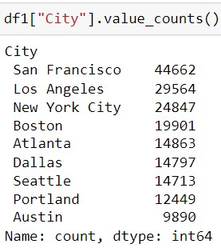

Slide 17
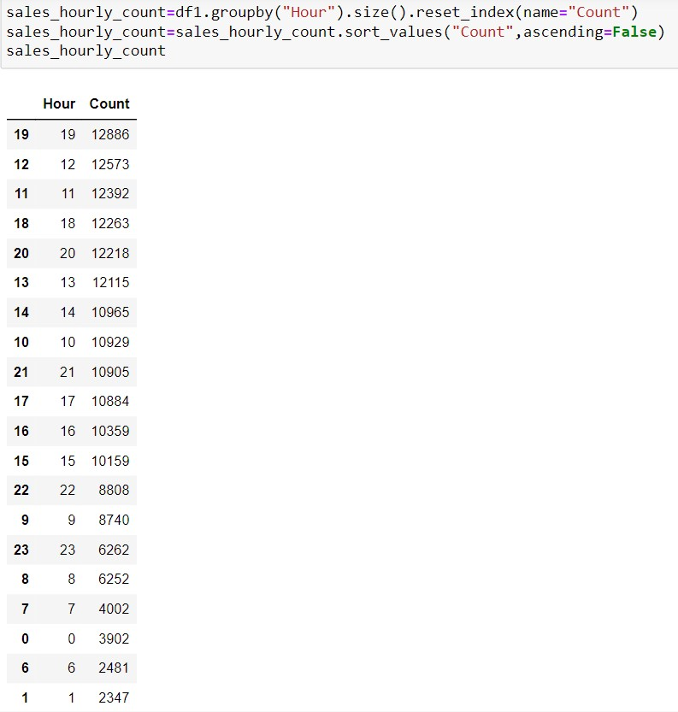

Slide 18
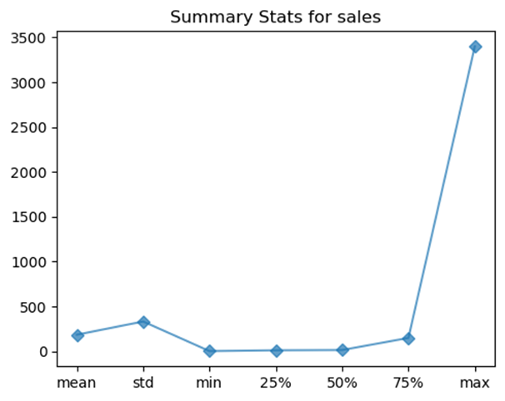
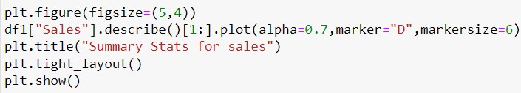
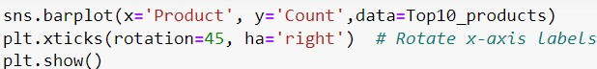
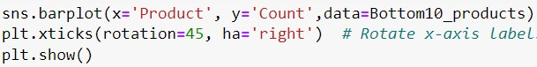
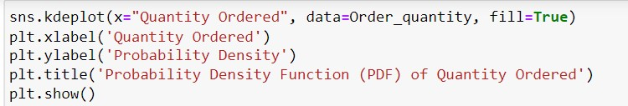

Slide 19
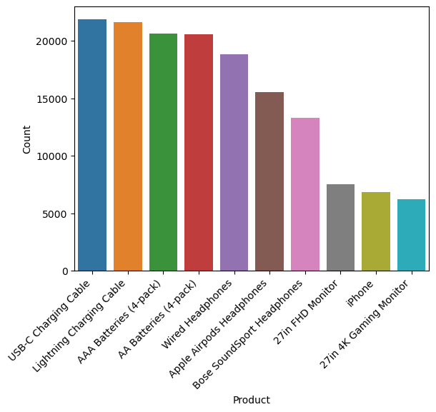
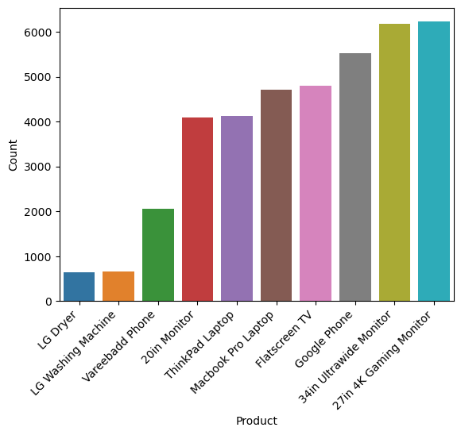

Slide 20
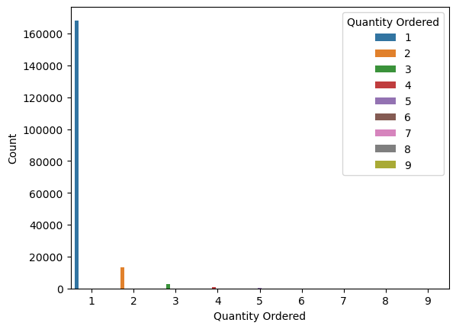
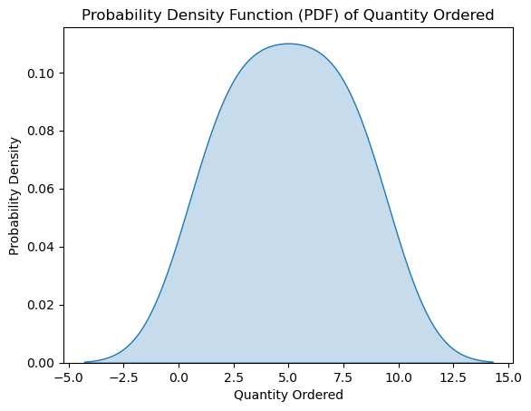

Slide 21
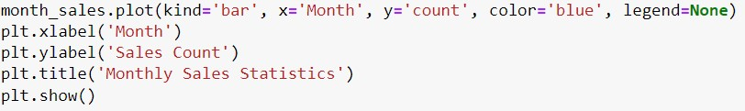
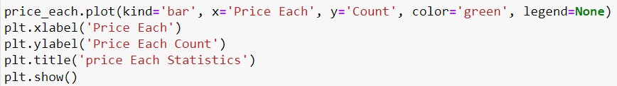
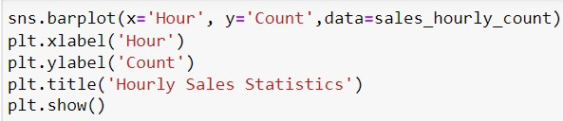
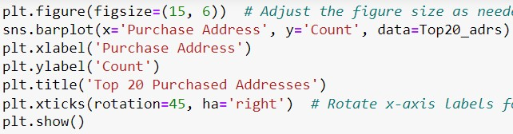
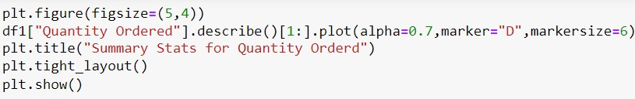

Slide 22
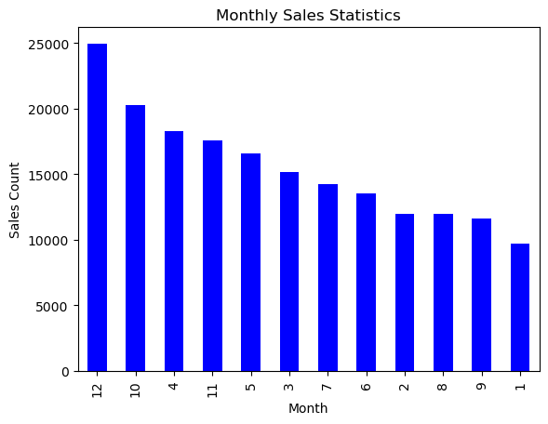
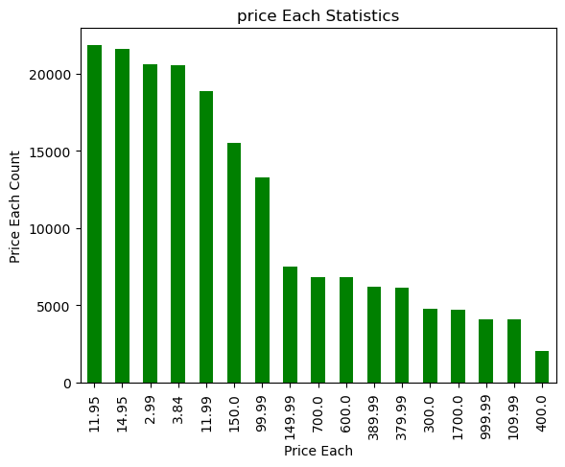

Slide 23
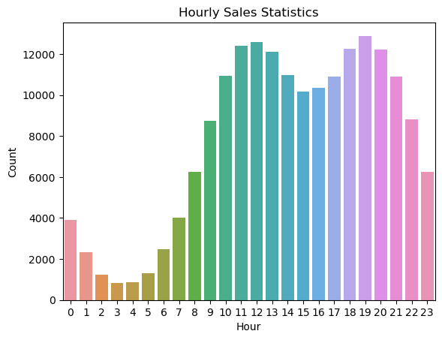
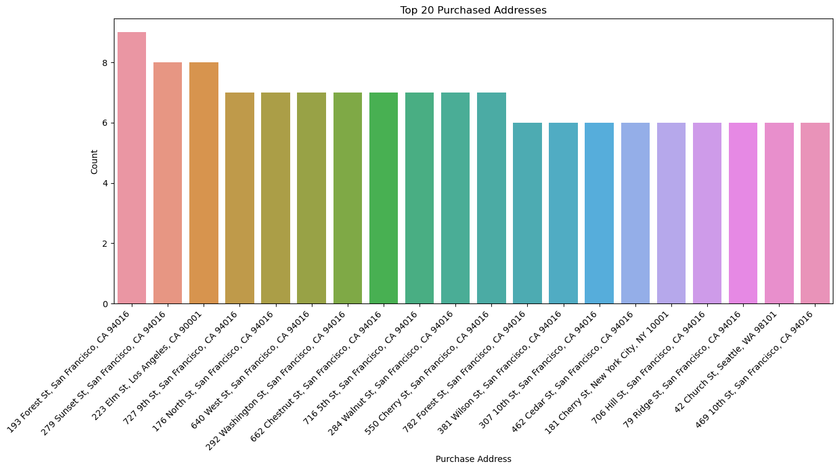
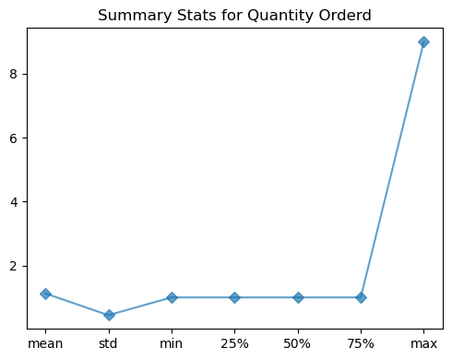

Slide 24
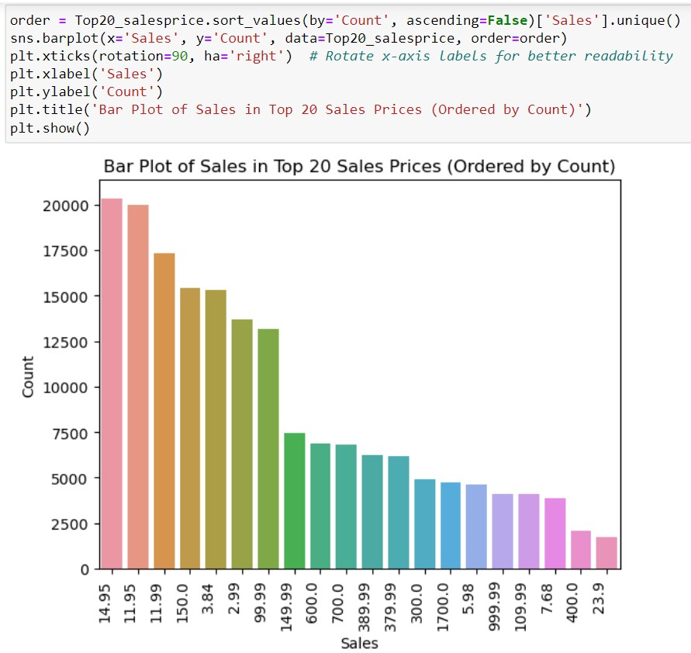

Slide 25
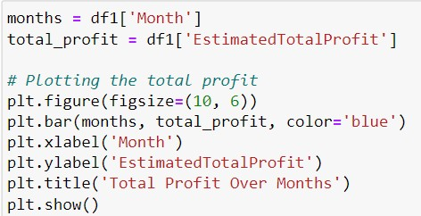
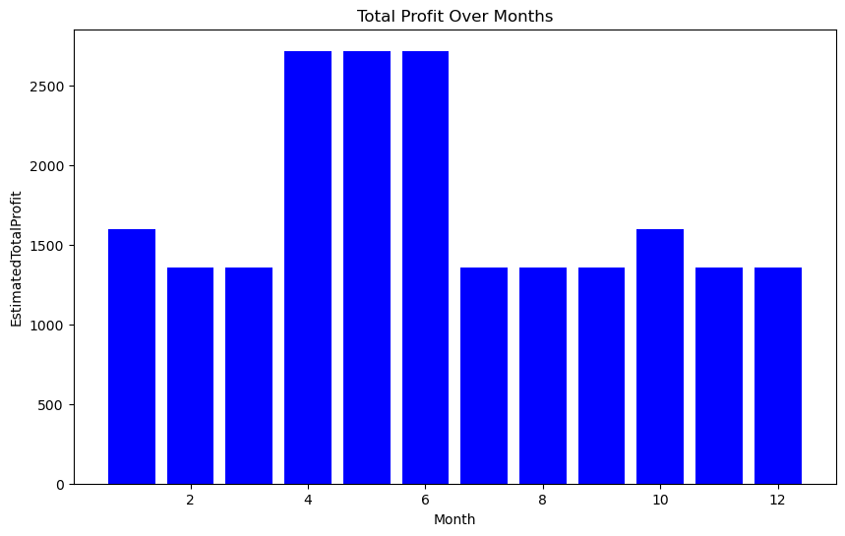

Slide 26
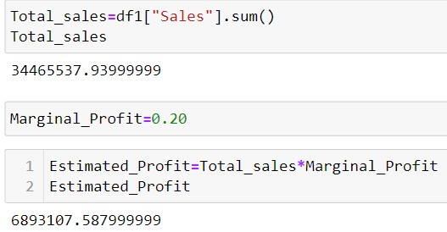
Total Estimated Profit:
The Estimated Profit Margin is 0.20
Estimated Total Profit:
The estimated total profit is 6.90M, indicating a substantial financial impact and potential for business growth

Slide 27
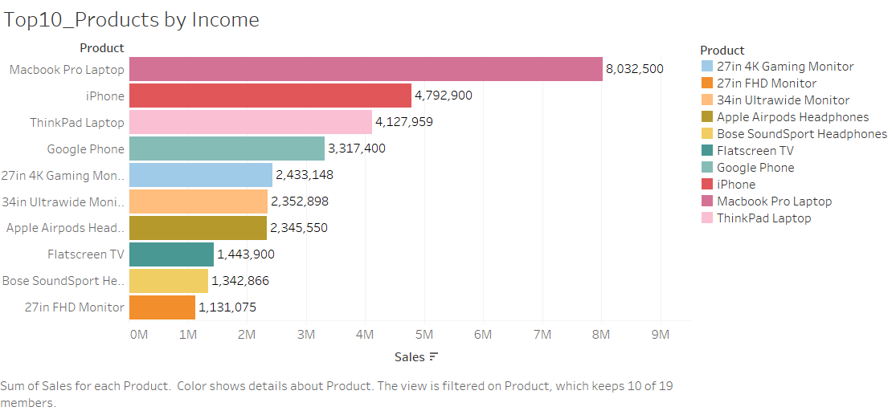
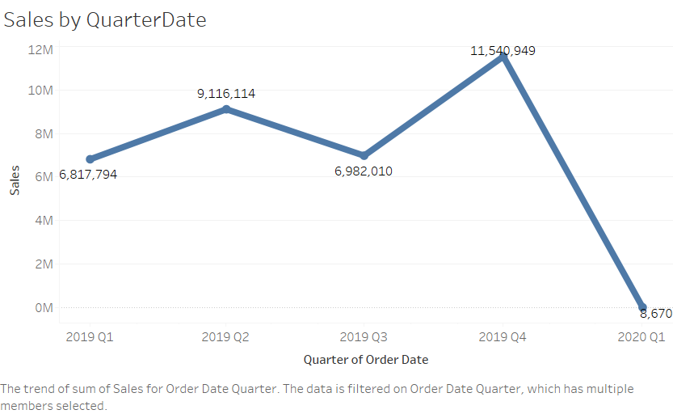
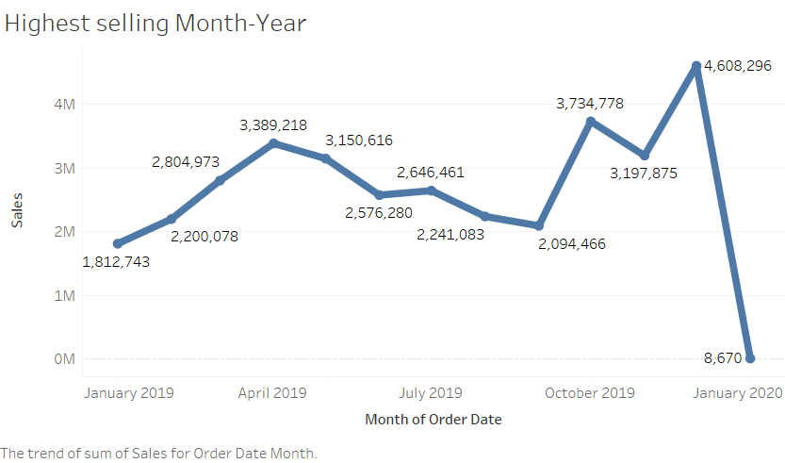
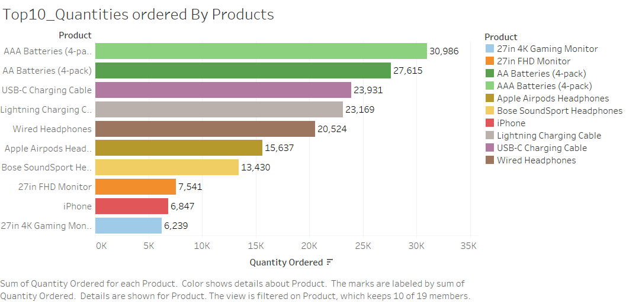

Slide 28
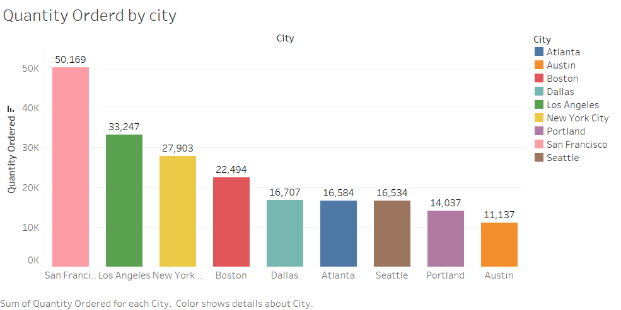
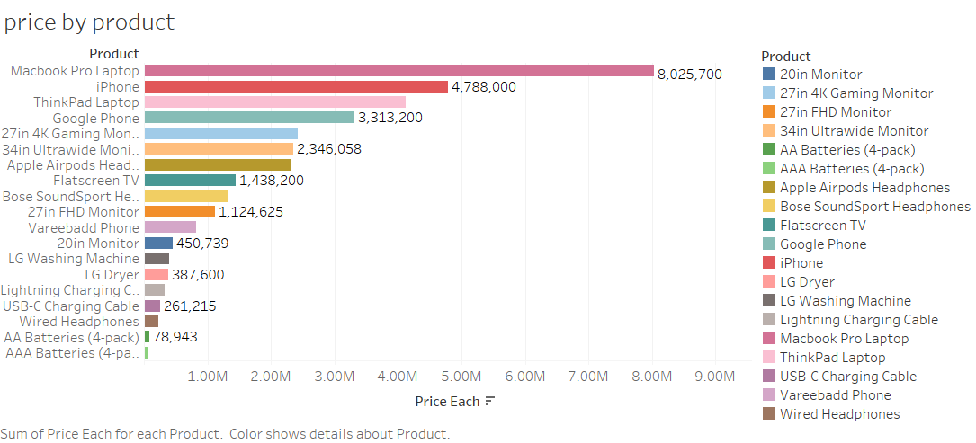
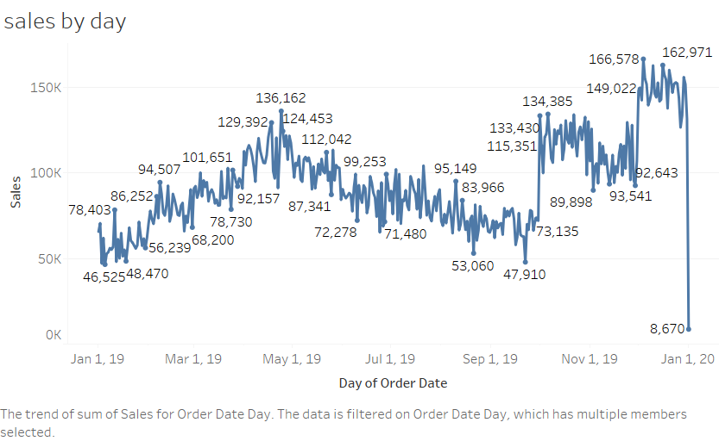
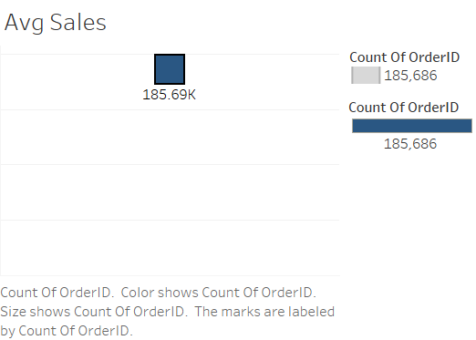
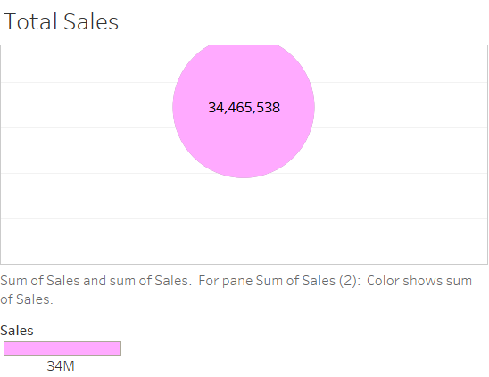
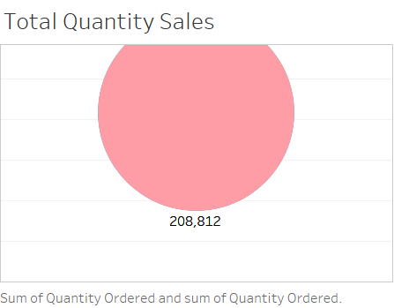

Slide 29
CONCLUSION :
The US Sales Data comprises 185.69K orders and includes information on various aspects of product sales, customer behavior, and regional performance. Key findings from the analysis include:
Order Statistics:
The dataset encompasses 185.69K orders, reflecting the scale of sales operations
Top-Selling Products:
USB-C charging cables and Lightning charging cables emerge as the best-selling products, indicating their popularity among customers
Customer Preferences:
A significant majority of customers prefer to order a single quantity, emphasizing a trend towards individual item purchases.
Pricing Impact:
Products priced at $11.95 and $14.95 exhibit higher sales, suggesting their attractiveness to customers
Temporal Trends:
December 4, 2019, stands out as the date with the highest number of orders, showcasing temporal variations in sales.

Slide 30
Continued…
Geographical Influence:
San Francisco leads in product purchases, with Los Angeles and New York following closely. This geographical insight can inform targeted marketing efforts.
Optimal Selling Hours:
The 19th hour (7 PM) experiences a rush hour with increased orders, and the time period from 1 PM to 12 PM is identified as the best-selling period
Monthly Sales Variation:
January records lower sales compared to December, suggesting potential seasonal influences.
Costliest Product Identification:
The MacBook Pro Laptop is identified as the costliest product in the inventory.
Sales Metrics:
The average sales and total sales metrics provide a comprehensive overview of the overall sales performance.
Estimated Total Profit:
The estimated total profit is 6.90M, indicating a substantial financial impact and potential for business growth

Slide 31

THANK YOU

